Slide 1
Irregular Stem Growth in Artemisia tridentata
var. wyomingensis
Tiffany Kharran
Manhattan College
Biology Department

Slide 2
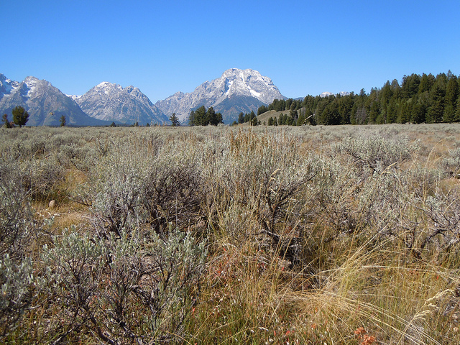
What is Artemisia tridentata- Big Sagebrush?
www.flickr.com

Slide 3
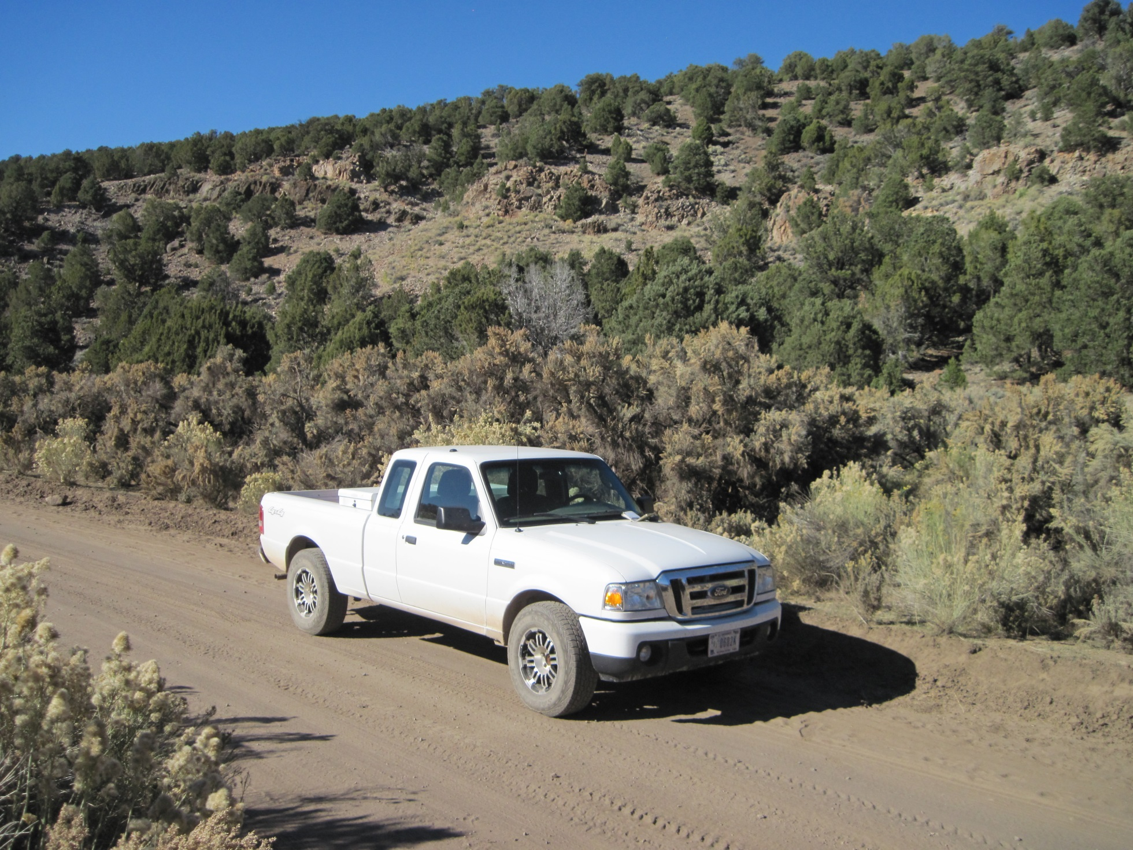
Photo courteous of Stanley Kitchen

Slide 4
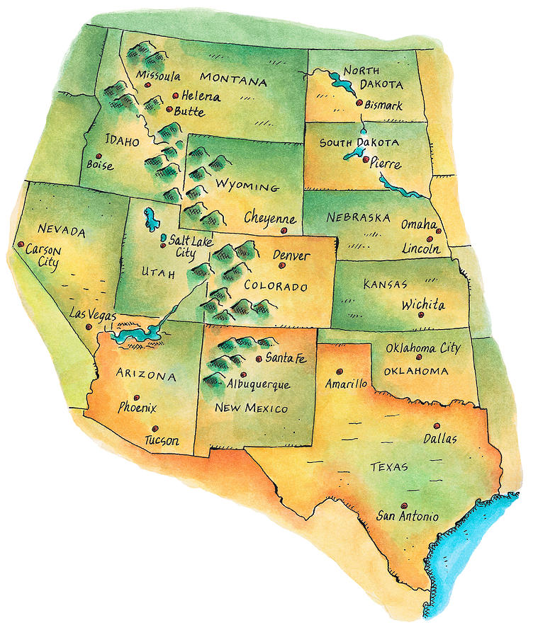
Where is Artemisia tridentata found?
fineartamerica.com

Slide 5
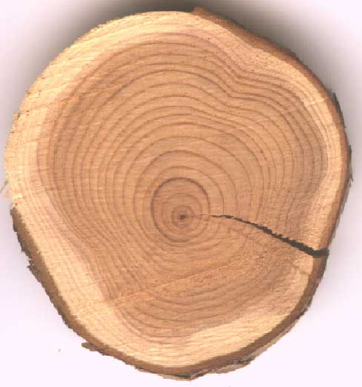
What are Xylary Rings?
http://woodmagic.vt.edu/html/activities/wpa0.htm

Slide 6
What is Irregular Growth?
Irregular growth is the uneven growth patterns of xylary rings (Diettert 1938)
During irregular growth the death of the vascular cambium causes uneven non circular growth rings
The death of the vascular cambium is a result of the death of determinate flowering branches at the point of attachment

Slide 7
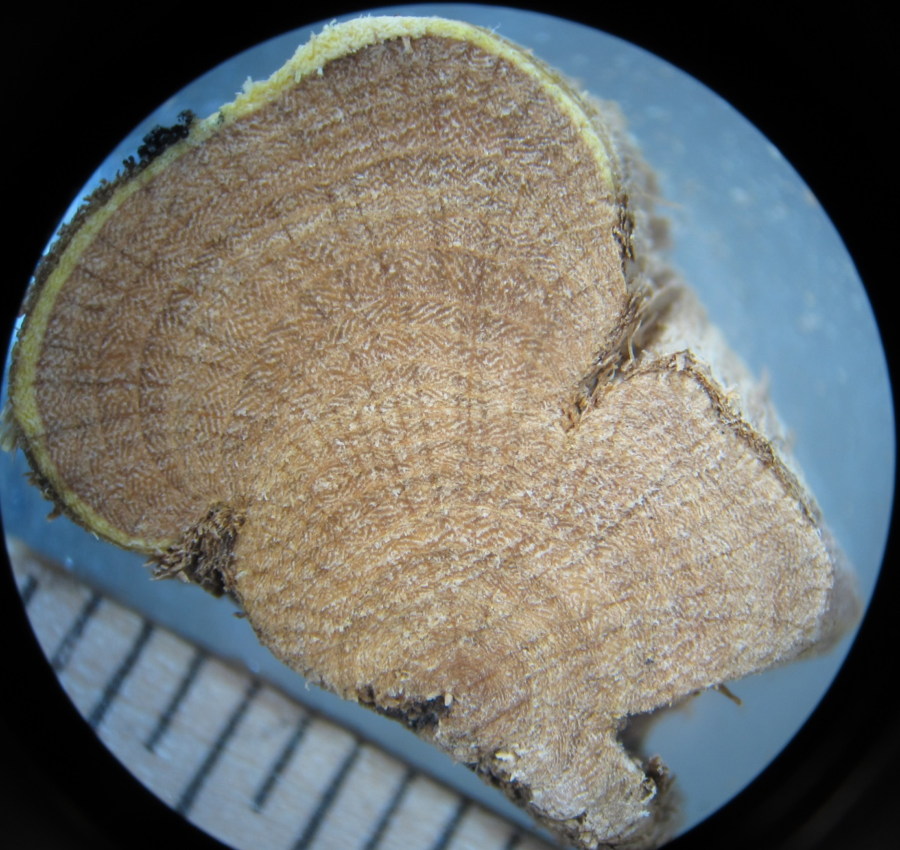
What is Irregular Growth?
(Irregular xylary rings)

Slide 8
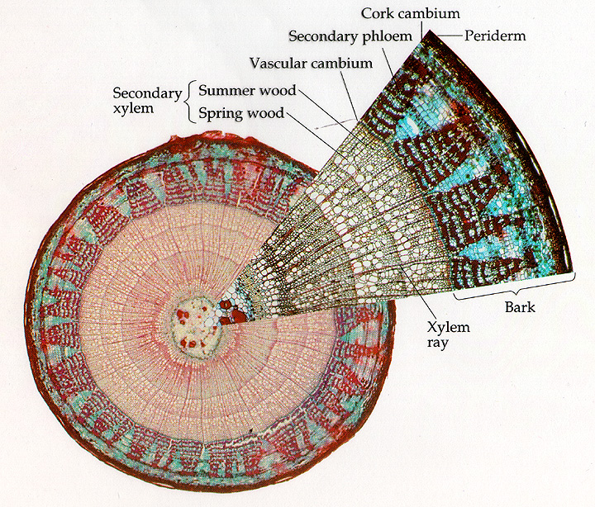
Xylary rings are produced by the vascular cambium
www.bio.miami.edu
In areas where the VC dies, no xylary rings will be produced

Slide 9
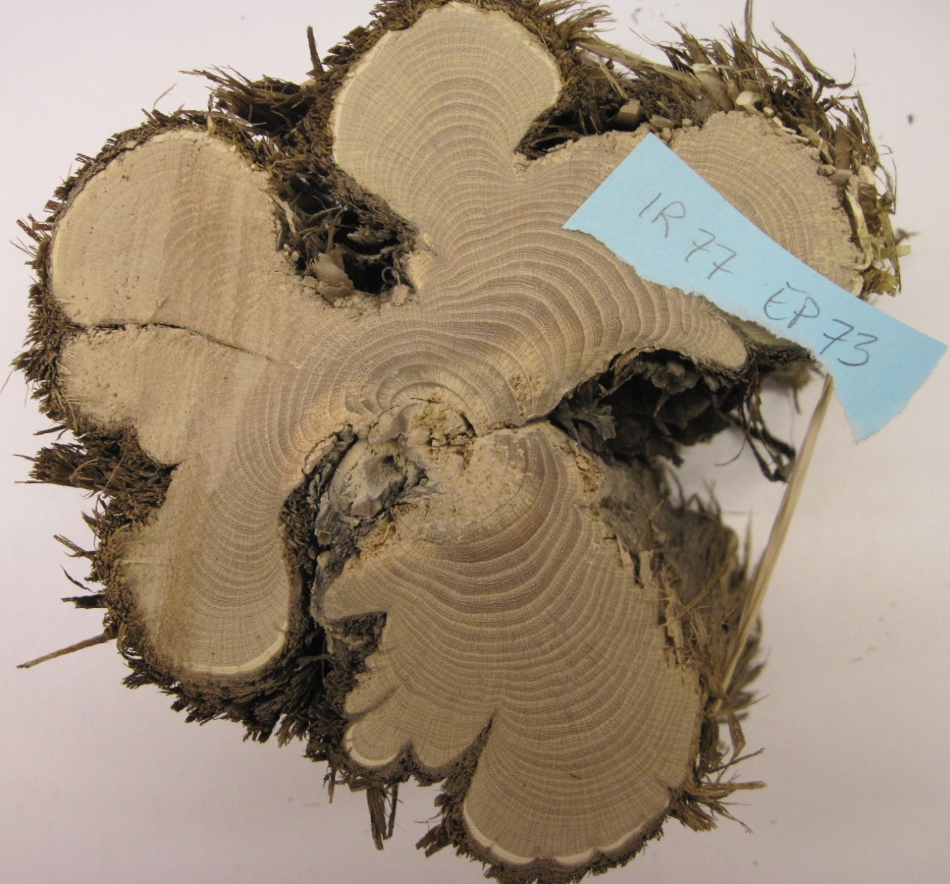
Purpose
To model the irregular growth patterns in Artemisia tridentata stems.

Slide 10
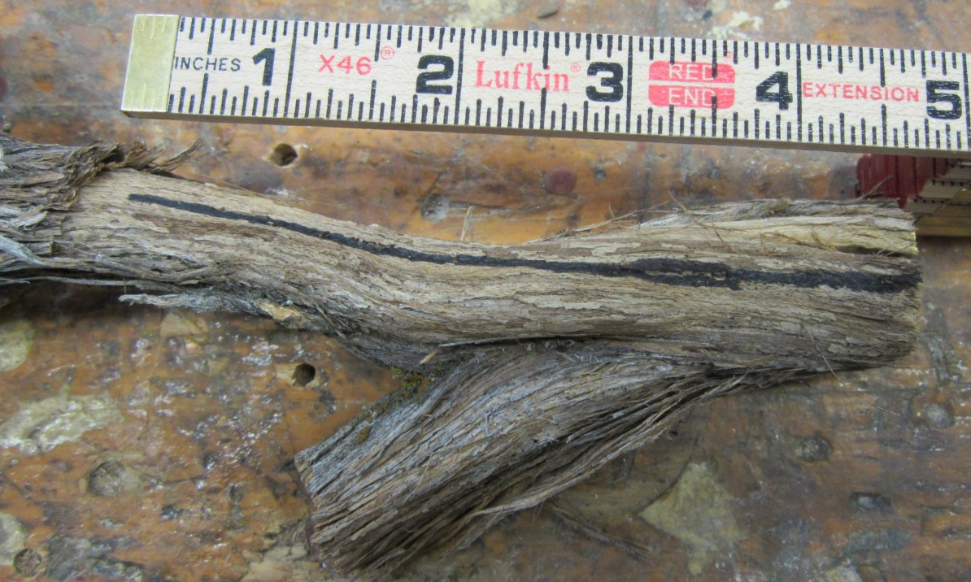
Materials and Methods
Extraneous bark was peeled away from the stem
A black line was drawn on the stem segment to maintain proper
orientation of samples

Slide 11
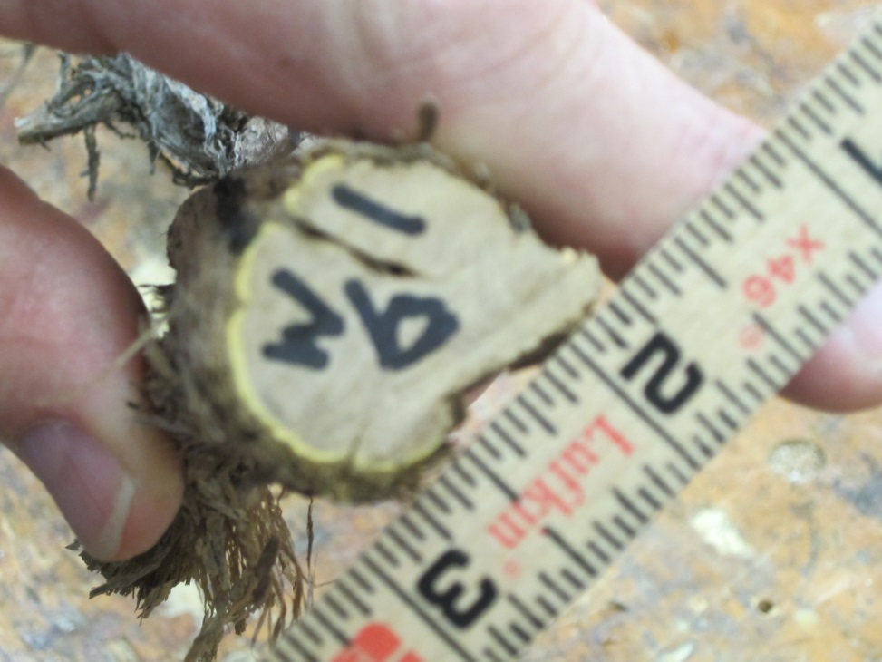
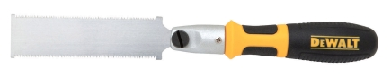
Sample Cutting Process
3. 66 wood samples were cut by Jason Durney at the Manhattan College
Wood shop

Slide 12
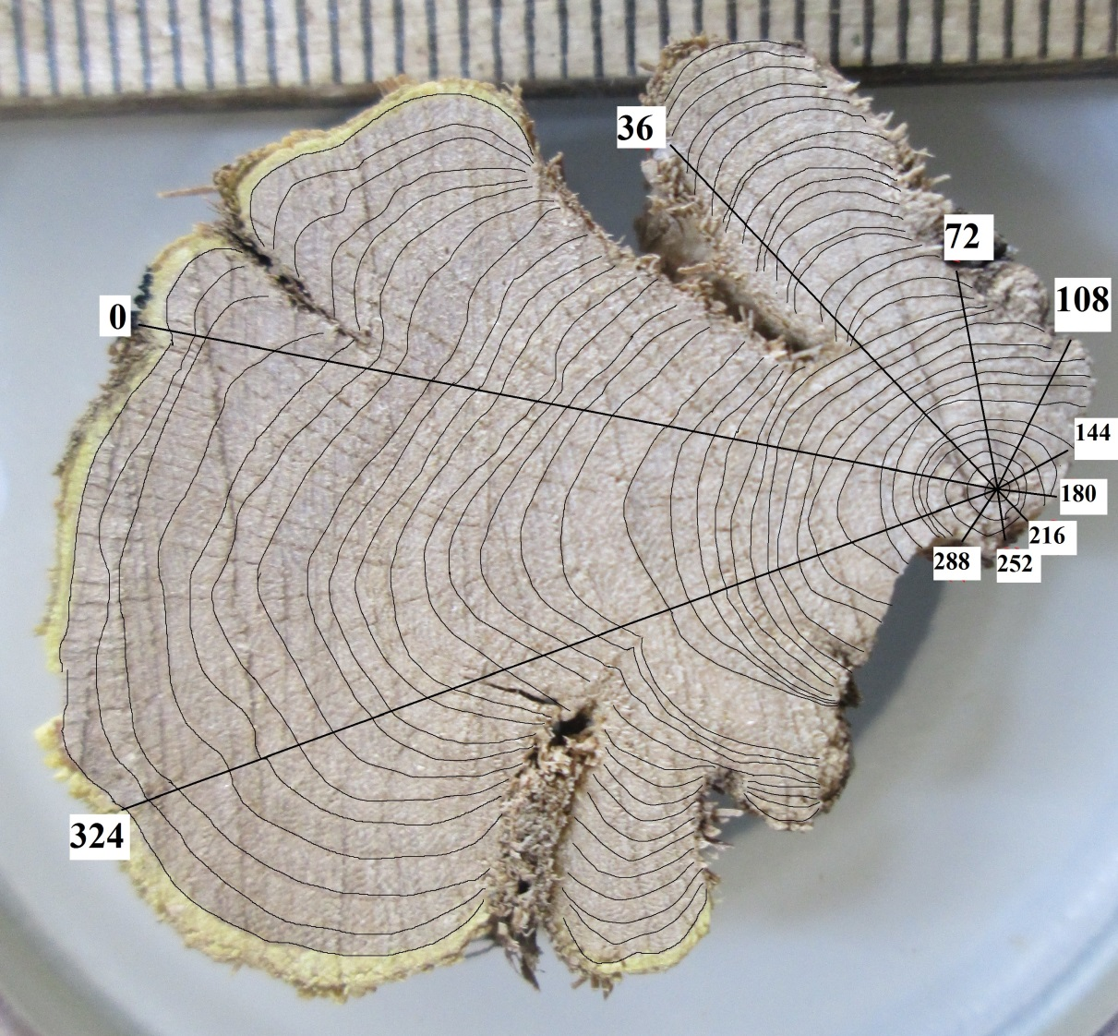
Materials and Methods
4. Xylary rings were traced using Microsoft Paint
5. Transects - 0, 36, 72, 108,144, 180, 216, 252, 288, 324

Slide 13

Materials and Methods
6. Number of xylem rings were counted

Slide 14
Selected Sample Characteristics
Sample Number | Cumulative Distance (mm) | Diameter (mm) | Number of xylem rings
1 | 0 | 30 | 34
9 | 84 | 32.3 | 30
19 | 181 | 18.9 | 25
29 | 279 | 14.7 | 21
39 | 360 | 15.8 | 20
49 | 435 | 10 | 15
59 | 501 | 5.9 | 9
65 | 550 | 3.5 | 7

Slide 15
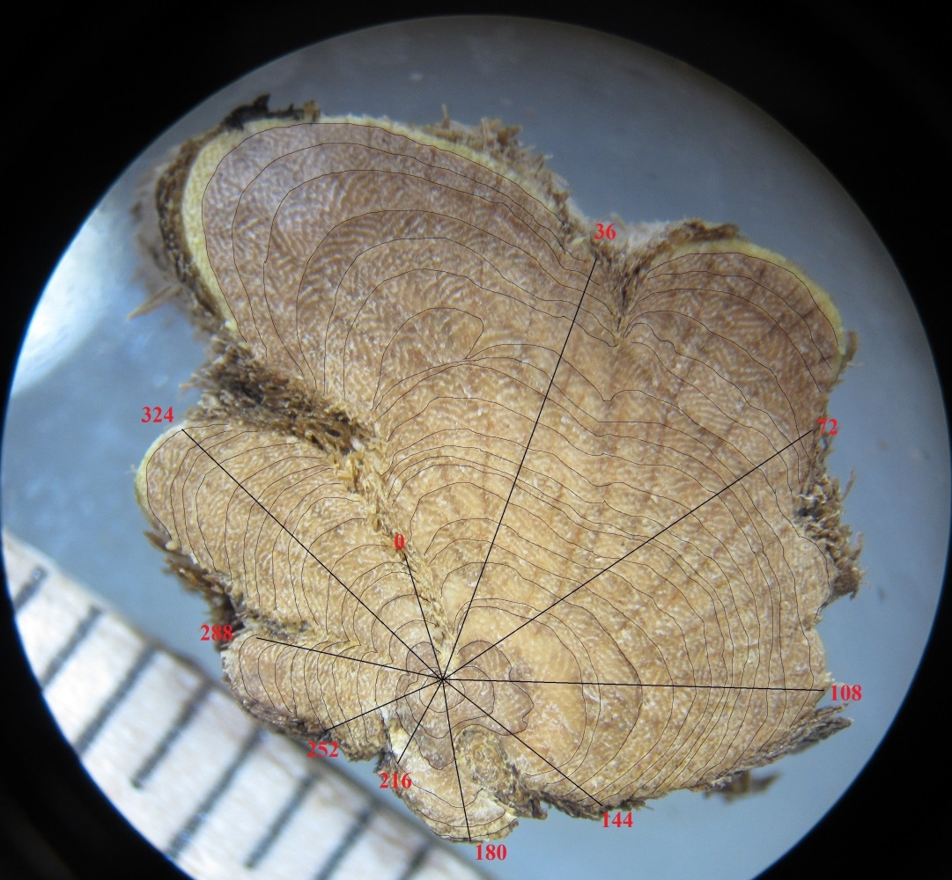
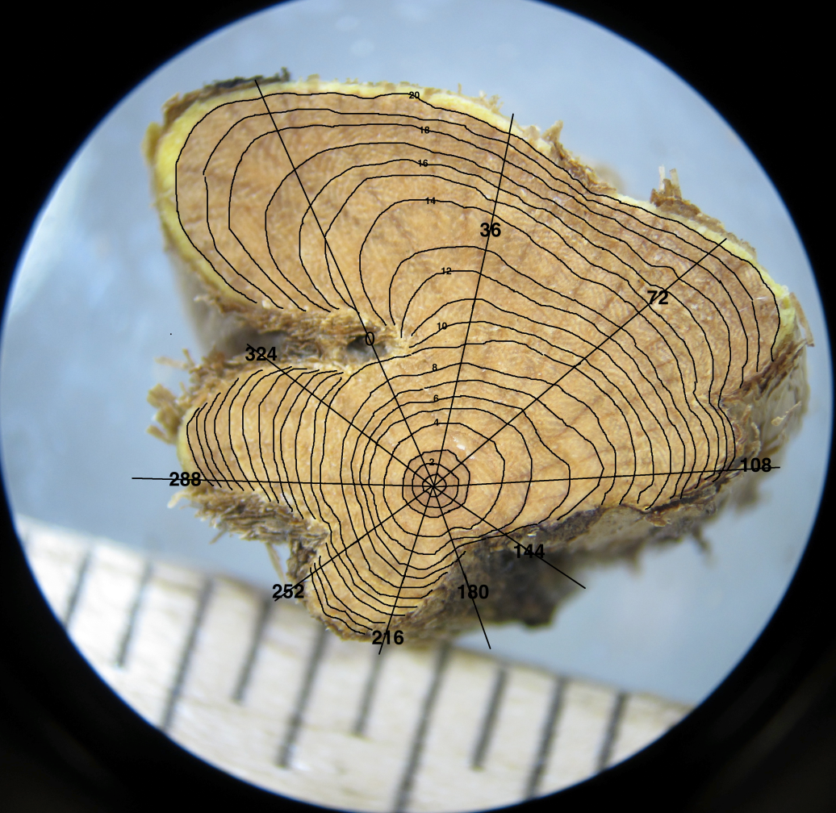
Compare xylary rings between samples 26 and 27
SAMPLE 26
SAMPLE 27
Samples are 10.1 mm apart.

Slide 16
Compare xylary rings between samples 26 and 27
 |  |  | NUMBER OF XYLEM RINGS
Transects | 0 | 36 | 72 | 108 | 144 | 180 | 216 | 252 | 288 | 324
SAMPLE
26 | 7 | 1 | 22 | 18 | 10 | 4 | 6 | 9 | 13 | 19
27 | 8 | 19 | 19 | 14 | 5 | 5 | 11 | 13 | 19 | 14

Slide 17
Compare xylary rings between samples 26 and 27
SAMPLE 26
SAMPLE 27
Samples are 10.1 mm apart.

Slide 18
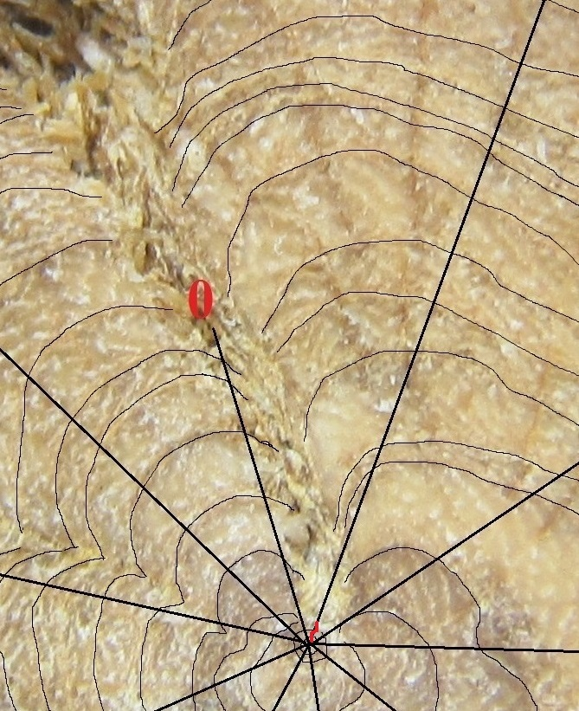
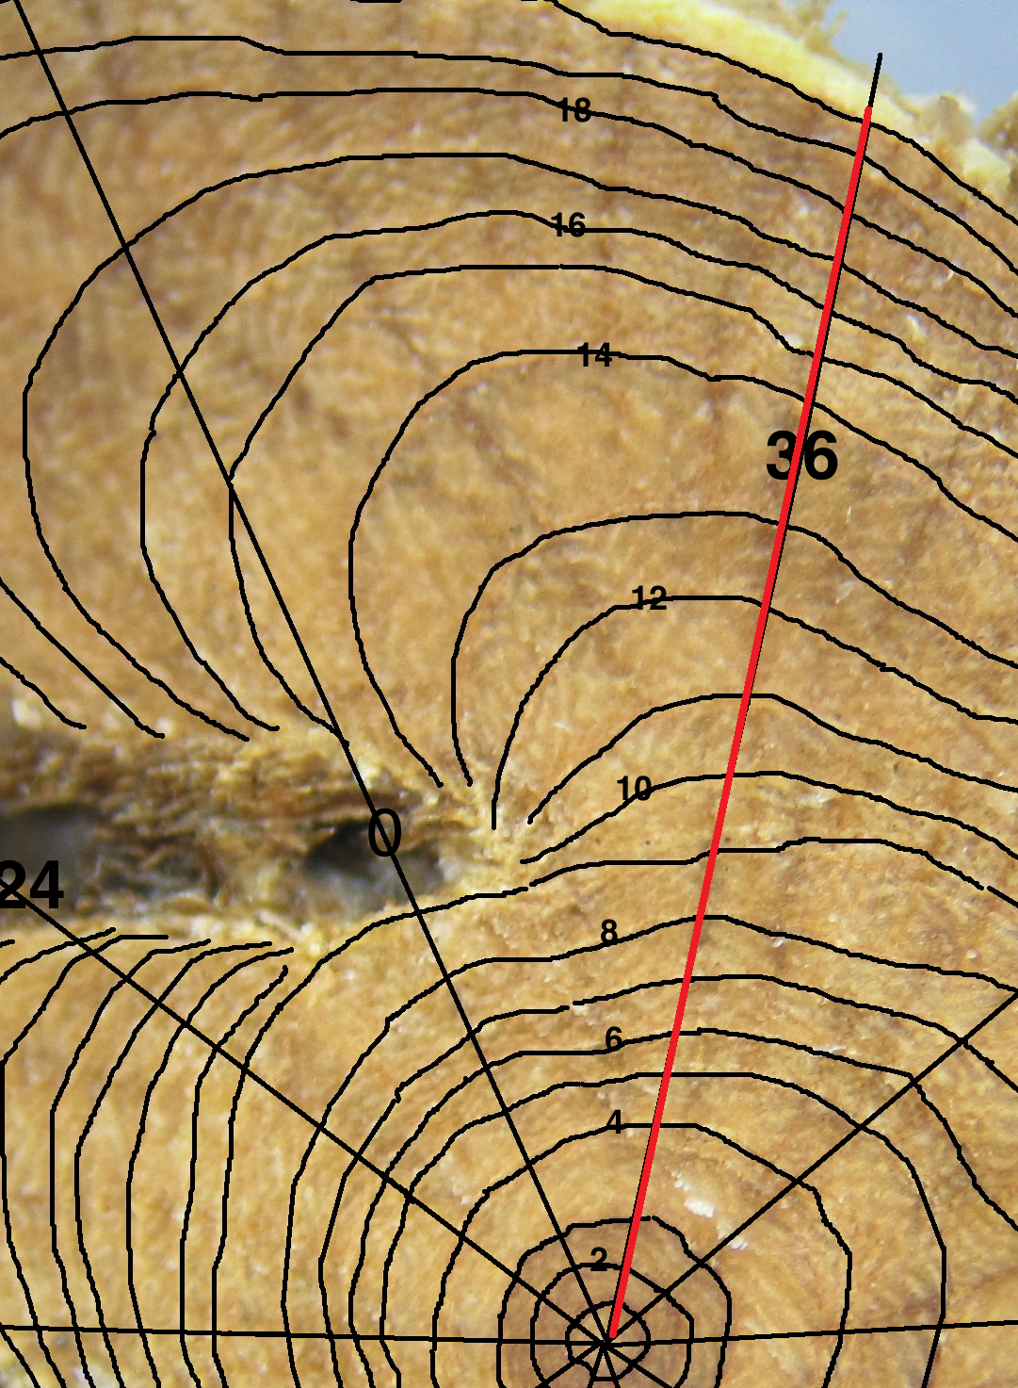
Compare xylary rings between samples 26 and 27
36
SAMPLE 26- 1 ring
SAMPLE 27- 19 rings

Slide 19
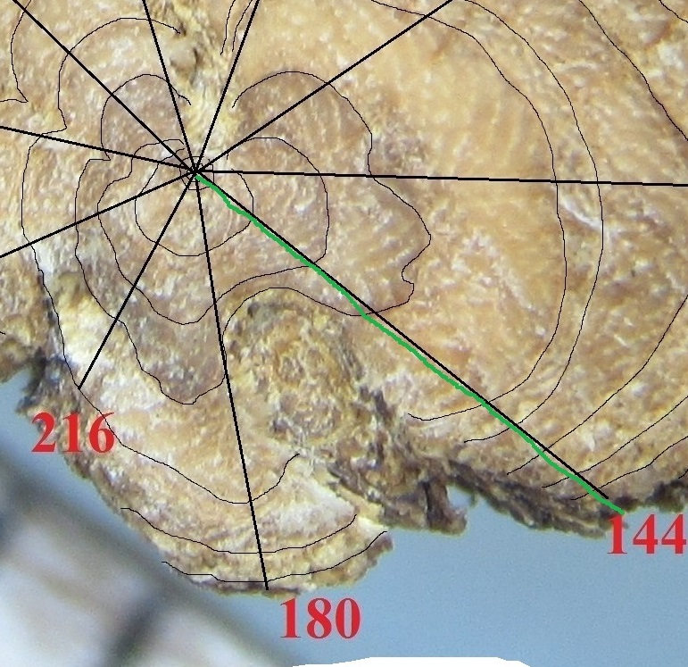
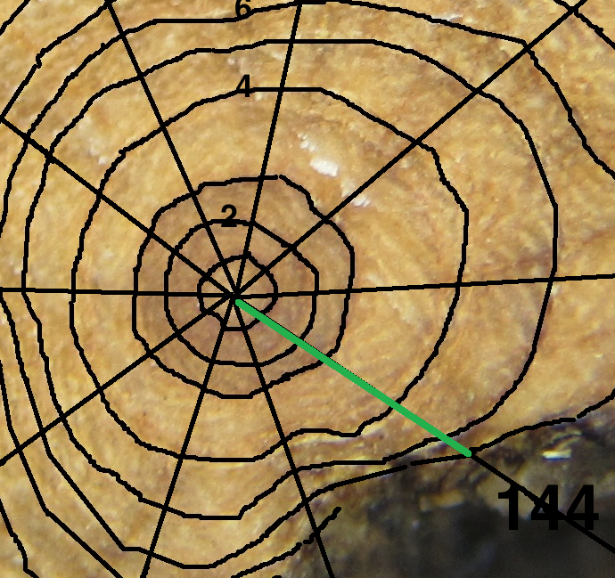
Compare xylary rings between samples 26 and 27
SAMPLE 26- 10 rings
SAMPLE 27- 5 rings

Slide 20
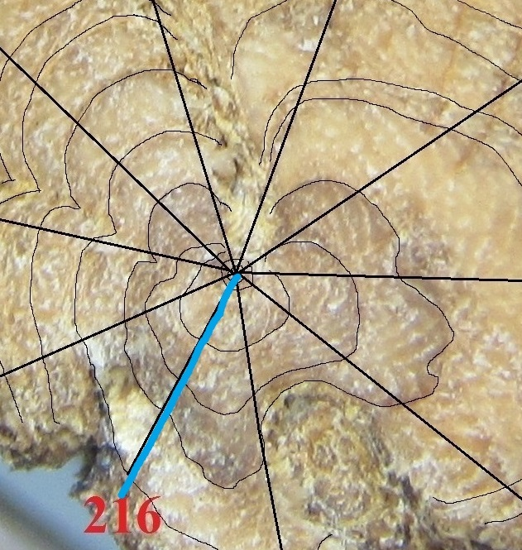
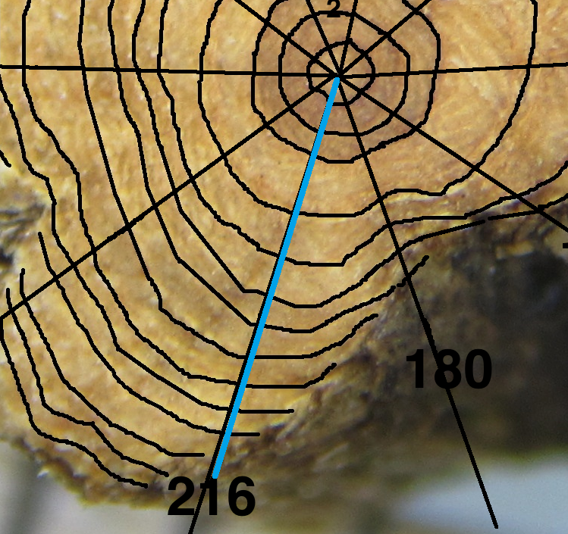
Compare xylary rings between samples 26 and 27
SAMPLE 26- 6 rings
SAMPLE 27- 11 rings

Slide 21
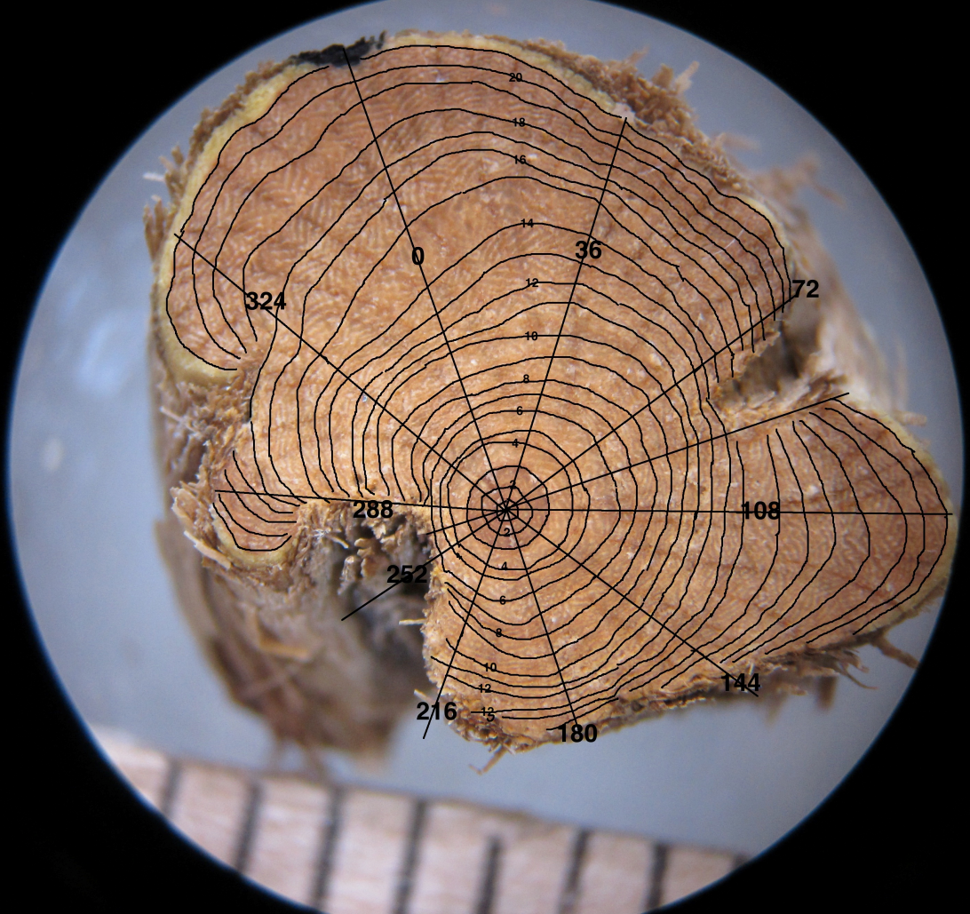
Compare xylary rings between samples 27 and 28
SAMPLE 27
SAMPLE 28
Samples are 8.54mm apart.

Slide 22
Compare xylary rings between samples 27 and 28
 |  |  | NUMBER OF XYLEM RINGS
Transects | 0 | 36 | 72 | 108 | 144 | 180 | 216 | 252 | 288 | 324
SAMPLE
27 | 8 | 19 | 19 | 14 | 5 | 5 | 11 | 13 | 19 | 14
28 | 20 | 20 | 20 | 20 | 16 | 14 | 11 | 5 | 5 | 20

Slide 23
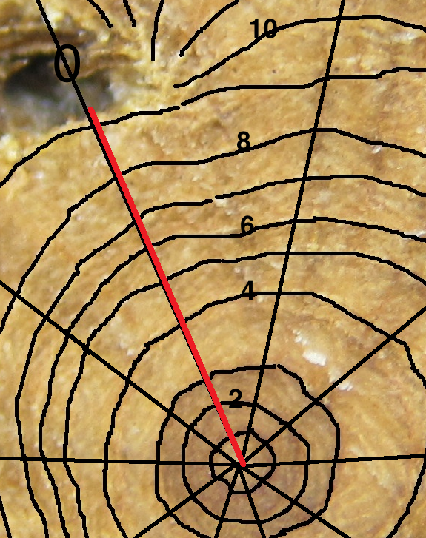
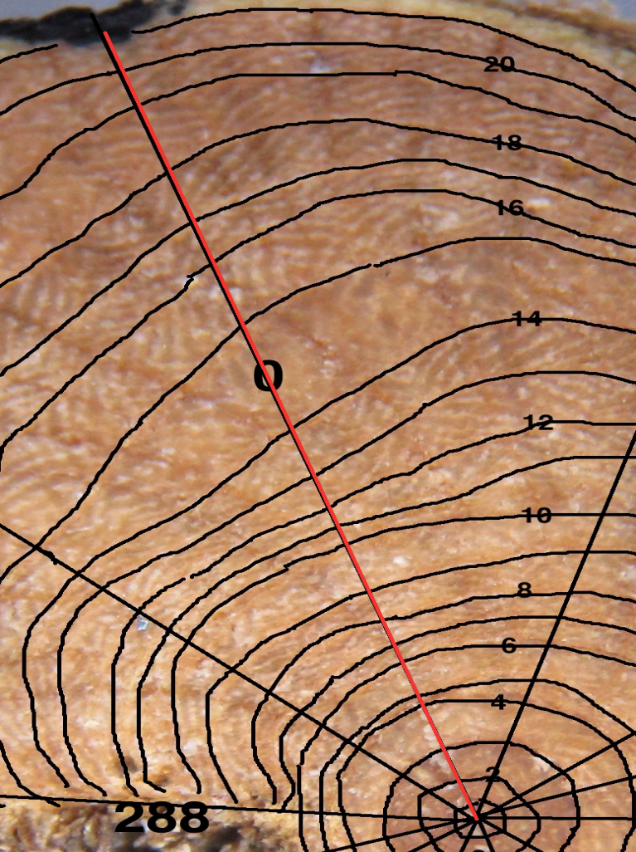
Compare xylary rings between samples 27 and 28
SAMPLE 27- 8 rings
SAMPLE 28- 20 rings

Slide 24
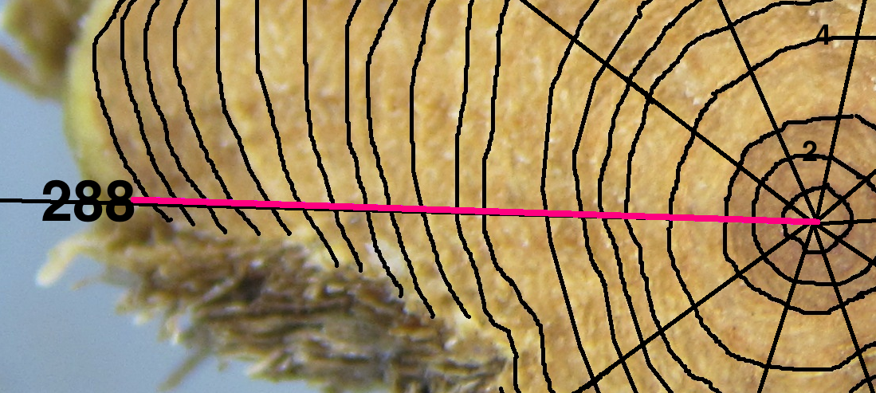
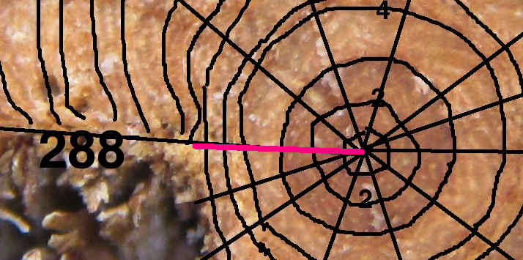
Compare xylary rings between samples 27 and 28
SAMPLE 27-19 rings
SAMPLE 28- 5 rings

Slide 25
NUMBER OF XYLEM RINGS
 | Transect |  | 0 | 36 | 72 | 108 | 144 | 180 | 216 | 252 | 288 | 324
 | SAMPLE | Distance (mm)
 | 24 | 0 | 8 | 23 | 9 | 0 | 0 | 0 | 0 | 3 | 5 | 24
 | 25 | 8.5 | 20 | 20 | 6 | 0 | 0 | 0 | 0 | 0 | 0 | 2
 | 26 | 17.1 | 7 | 1 | 22 | 18 | 10 | 4 | 6 | 9 | 13 | 19
 | 27 | 27.2 | 8 | 19 | 19 | 14 | 5 | 5 | 11 | 13 | 19 | 14
 | 28 | 35.7 | 20 | 20 | 20 | 20 | 16 | 14 | 11 | 5 | 5 | 20
 | 29 | 56 | 8 | 20 | 20 | 8 | 19 | 1 | 11 | 21 | 21 | 17

Slide 26
To model the irregular growth patterns in Artemisia tridentata stems.

Slide 27
I can be emailed at
tkharran.student@manhattan.edu

